Slide 1
Predicting mechanical properties of zeolites using Deep Learning

Slide 2
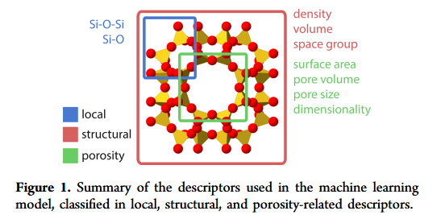
Machine learning approach relying on geometric features only,

Slide 3
